Slide 1
COT5615: Math for Intelligent Systems I
Anand Rangarajan
Lecture 30

Slide 2
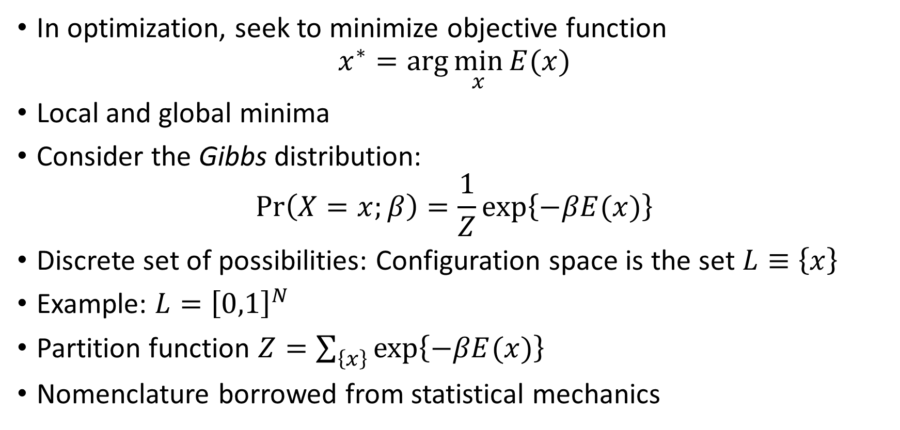
The Link Between Optimization and Statistics
In optimization, seek to minimize objective function
$$x^{∗}=\arg{\min_{x}{E(x)}}$$
Local and global minima
Consider the Gibbs distribution:
$$\operatorname{Pr}\left(X=x;β\right)=\frac{1}{Z}\exp\left\{−βE(x)\right\}$$
Discrete set of possibilities: Configuration space is the set $L≡\left\{x\right\}$
Example: $L={\left[0,1\right]}^{N}$
Partition function $Z=\sum_{\left\{x\right\}}{\exp\left\{−βE(x)\right\}}$
Nomenclature borrowed from statistical mechanics

Slide 3
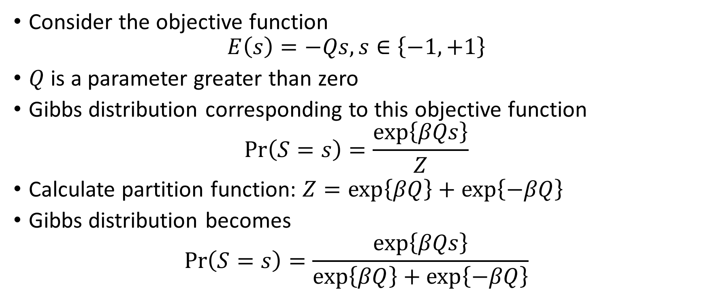
A Simple Example
Consider the objective function
$$E\left(s\right)=−Qs, s∈\left\{−1,+1\right\}$$
$Q$ is a parameter greater than zero
Gibbs distribution corresponding to this objective function
$$\operatorname{Pr}\left(S=s\right)=\frac{\exp\left\{βQs\right\}}{Z}$$
Calculate partition function: $Z=\exp\left\{βQ\right\}+\exp\left\{−βQ\right\}$
Gibbs distribution becomes
$$\operatorname{Pr}\left(S=s\right)=\frac{\exp\left\{βQs\right\}}{\exp\left\{βQ\right\}+\exp\left\{−βQ\right\}}$$

Slide 4
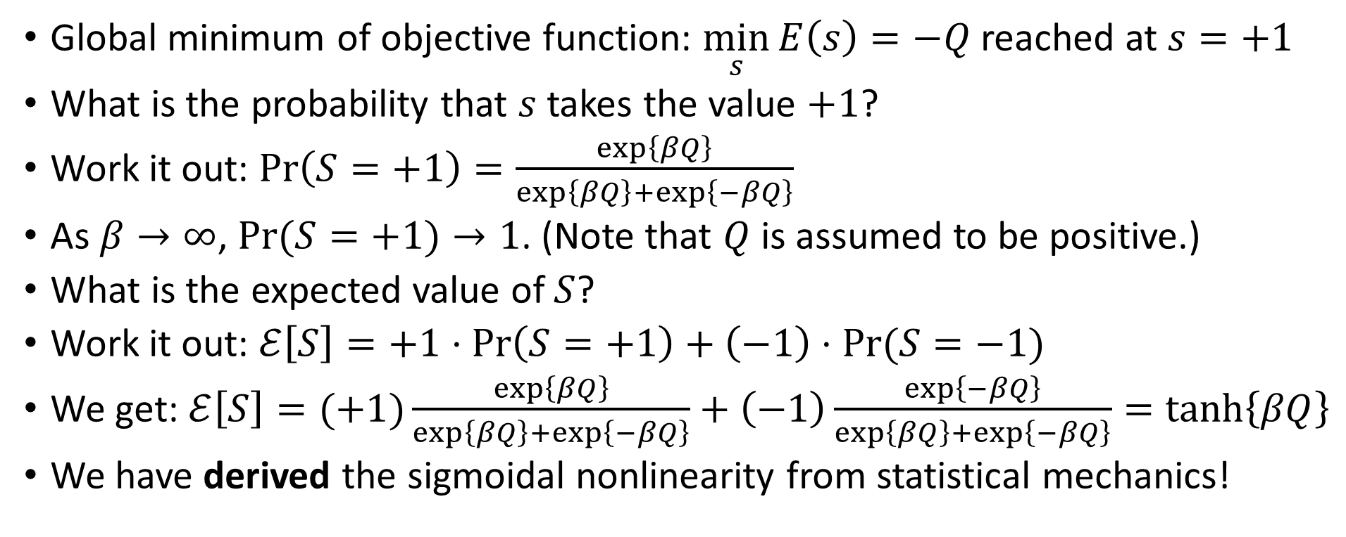
A Simple Example (contd.)
Global minimum of objective function: $\min_{s}{E\left(s\right)=−Q}$ reached at $s=+1$
What is the probability that $s$ takes the value $+1$?
Work it out: $\operatorname{Pr}\left(S=+1\right)=\frac{\exp\left\{βQ\right\}}{\exp\left\{βQ\right\}+\exp\left\{−βQ\right\}}$
As $β→∞$, $\operatorname{Pr}{(S=+1)}→1$. (Note that $Q$ is assumed to be positive.)
What is the expected value of $S$?
Work it out: $ℰ\left[S\right]=+1⋅\operatorname{Pr}\left(S=+1\right)+\left(−1\right)⋅\operatorname{Pr}{(S=−1)}$
We get: $ℰ\left[S\right]=(+1)\frac{\exp\left\{βQ\right\}}{\exp\left\{βQ\right\}+\exp\left\{−βQ\right\}}+\left(−1\right)\frac{\exp\left\{−βQ\right\}}{\exp\left\{βQ\right\}+\exp\left\{−βQ\right\}}=\tanh\left\{βQ\right\}$
We have derived the sigmoidal nonlinearity from statistical mechanics!

Slide 5
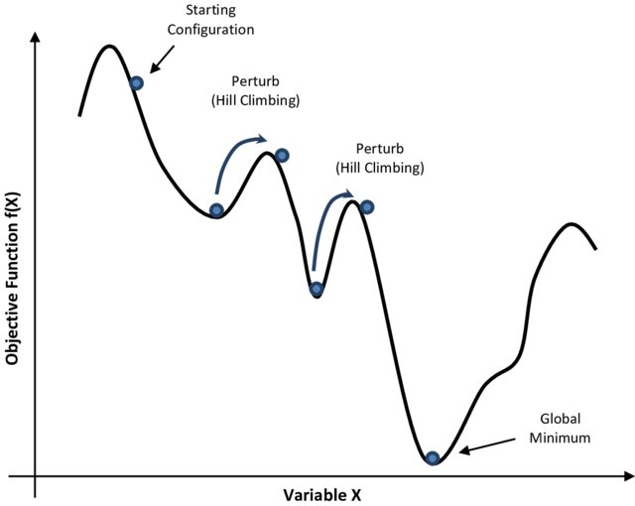
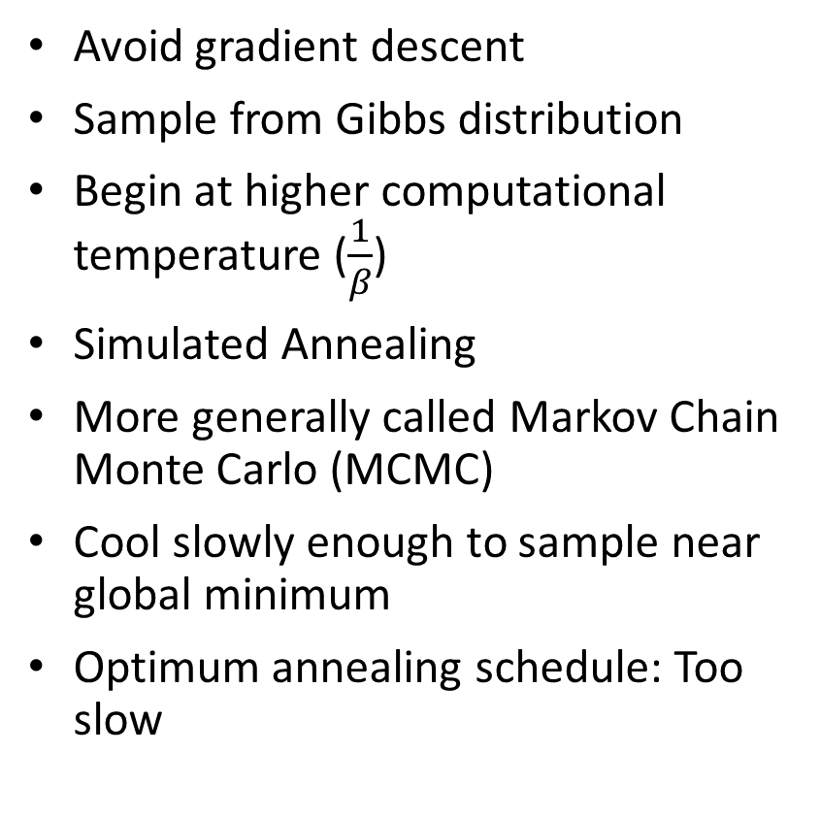
Global vs. Local Minima
Avoid gradient descent
Sample from Gibbs distribution
Begin at higher computational temperature ($\frac{1}{β}$)
Simulated Annealing
More generally called Markov Chain Monte Carlo (MCMC)
Cool slowly enough to sample near global minimum
Optimum annealing schedule: Too slow

Slide 6
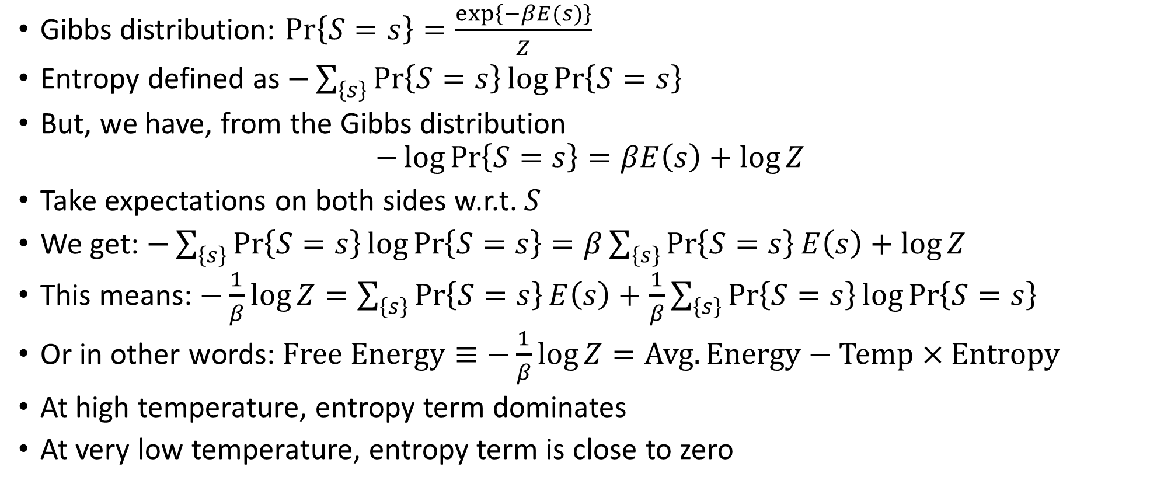
Entropy and Free Energy
Gibbs distribution: $\operatorname{Pr}\left\{S=s\right\}=\frac{\exp\left\{−βE(s)\right\}}{Z}$
Entropy defined as $−\sum_{\left\{s\right\}}{\operatorname{Pr}\left\{S=s\right\}}\log{\operatorname{Pr}\left\{S=s\right\}}$
But, we have, from the Gibbs distribution
$$−\log{\operatorname{Pr}\left\{S=s\right\}}=βE\left(s\right)+\log{Z}$$
Take expectations on both sides w.r.t. $S$
We get: $−\sum_{\left\{s\right\}}{\operatorname{Pr}\left\{S=s\right\}}\log{\operatorname{Pr}\left\{S=s\right\}}=β\sum_{\left\{s\right\}}{\operatorname{Pr}\left\{S=s\right\}}E\left(s\right)+\log{Z}$
This means: $−\frac{1}{β}\log{Z}=\sum_{\left\{s\right\}}{\operatorname{Pr}\left\{S=s\right\}}E\left(s\right)+\frac{1}{β}\sum_{\left\{s\right\}}{\operatorname{Pr}\left\{S=s\right\}}\log{\operatorname{Pr}\left\{S=s\right\}}$
Or in other words: $Free Energy≡−\frac{1}{β}\log{Z}=Avg. Energy−Temp×Entropy$
At high temperature, entropy term dominates
At very low temperature, entropy term is close to zero

Slide 7
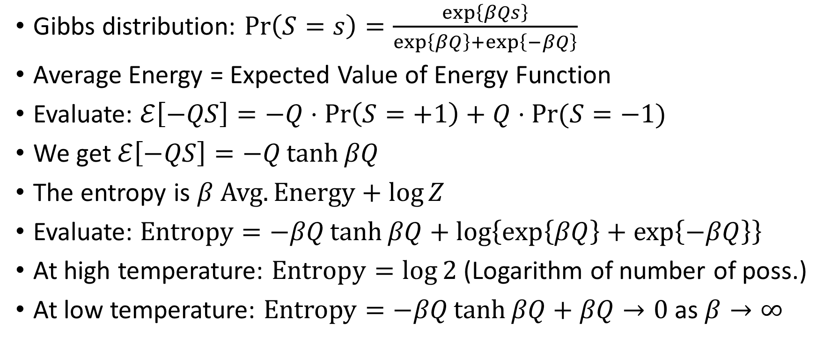
Back to Simple Example
Gibbs distribution: $\operatorname{Pr}\left(S=s\right)=\frac{\exp\left\{βQs\right\}}{\exp\left\{βQ\right\}+\exp\left\{−βQ\right\}}$
Average Energy = Expected Value of Energy Function
Evaluate: $ℰ\left[−QS\right]=−Q⋅\operatorname{Pr}\left(S=+1\right)+Q⋅\operatorname{Pr}{(S=−1)}$
We get $ℰ\left[−QS\right]=−Q\tanh{βQ}$
The entropy is $β Avg. Energy+\log{Z}$
Evaluate: $Entropy=−βQ\tanh{βQ}+\log\left\{\exp\left\{βQ\right\}+\exp\left\{−βQ\right\}\right\}$
At high temperature: $Entropy=\log{2}$ (Logarithm of number of poss.)
At low temperature: $Entropy=−βQ\tanh{βQ}+βQ→0$ as $β→∞$
Notes:
As beta goes to 0, the entropy is log of number of configurations. Reason being every configuration is equally likely. So prob are all equal to each other.
Entropy is kind of set of allowable configurations. At very low temp, only one allowable config which is at global minima. So since log1 is 0, so entropy goes to 0.

Slide 8
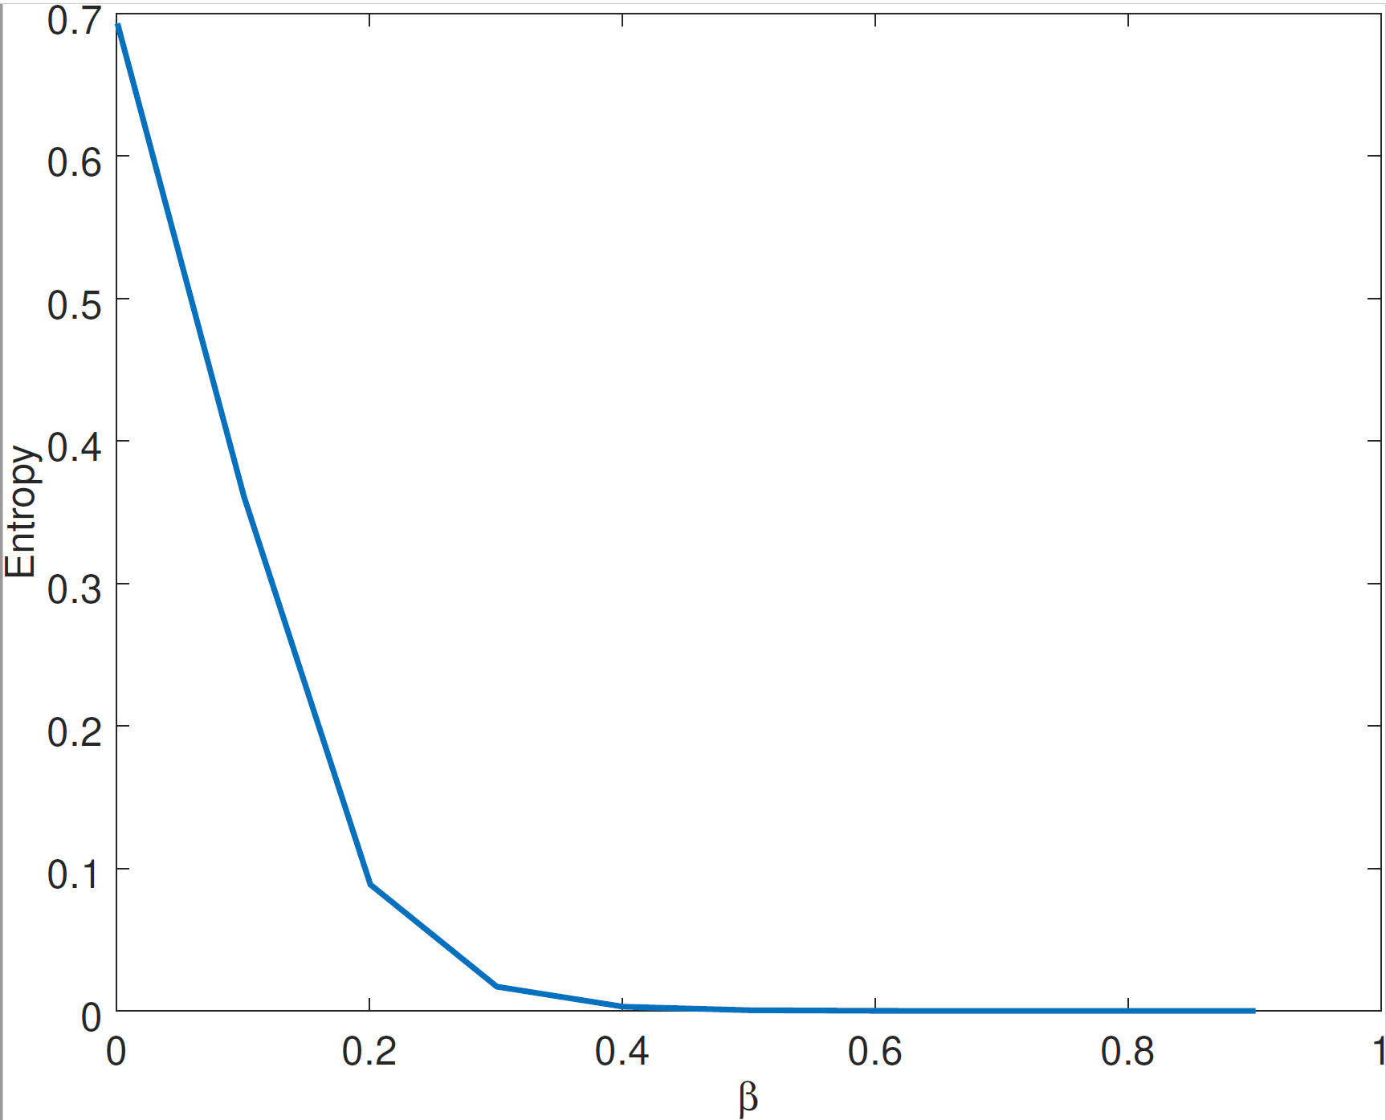
Entropy Plot: Simple Example

